Slide 1

Forecasting Consumer Spending Amounts Using Machine Learning and Time Series Analysis
Roy
20241007
Notes:
Robust
Significant

Slide 2
Research Objective
To predict the credit card transaction amounts for the upcoming month across various industries based on different age, income, and education groups, providing precise support for marketing and resource allocation decisions.
Practical Applications
Marketing Strategy Optimization
Deliver customized promotional campaigns targeting specific income and education groups to improve market response rates.
Credit Card Business Innovation
Design specialized credit card products for specific age and income groups (e.g., education industry cards, entertainment spending cards).
Adjust credit limits based on consumption predictions to mitigate financial risks.
IDA Template

Slide 3
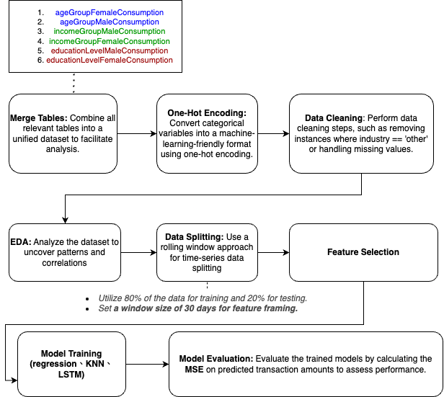
Flow chart
MAE
IDA Template

Slide 4
Data (data.gov.tw)
ageGroupFemaleConsumption：各年齡層女性持卡人於各行業別總簽帳金額及筆數
ageGroupMaleConsumption：各年齡層男性持卡人於各行業別總簽帳金額及筆數
incomeGroupMaleConsumption：各年收入族群男性持卡人於各行業別總簽帳金額及筆數
incomeGroupFemaleConsumption：各年收入族群女性持卡人於各行業別總簽帳金額及筆數
educationLevelMaleConsumption：各教育程度男性持卡人於六都消費樣態
educationLevelFemaleConsumption：各教育程度女性持卡人於六都消費樣態
IDA Template

Slide 5
Merge Tables -> One-Hot Encoding -> Data Cleaning -> Exploratory Data Analysis (EDA) -> Data Splitting -> Feature Selection -> Model Training -> Model Evaluation
IDA Template

Slide 6
Merge Tables -> One-Hot Encoding -> Data Cleaning -> Exploratory Data Analysis (EDA) -> Data Splitting -> Feature Selection -> Model Training -> Model Evaluation
IDA Template

Slide 7
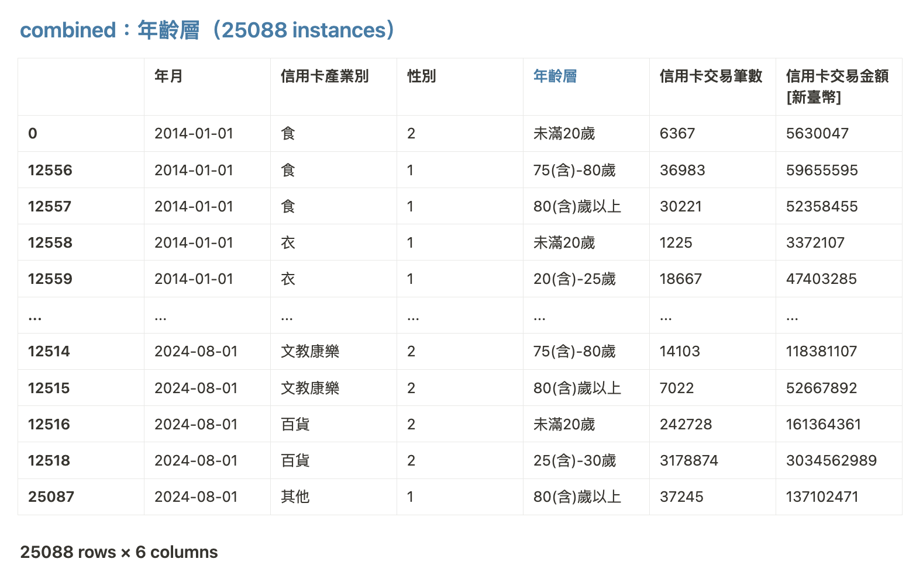
Merge Tables -> One-Hot Encoding -> Data Cleaning -> Exploratory Data Analysis (EDA) -> Data Splitting -> Feature Selection -> Model Training -> Model Evaluation
Merged table：Age Group
IDA Template

Slide 8
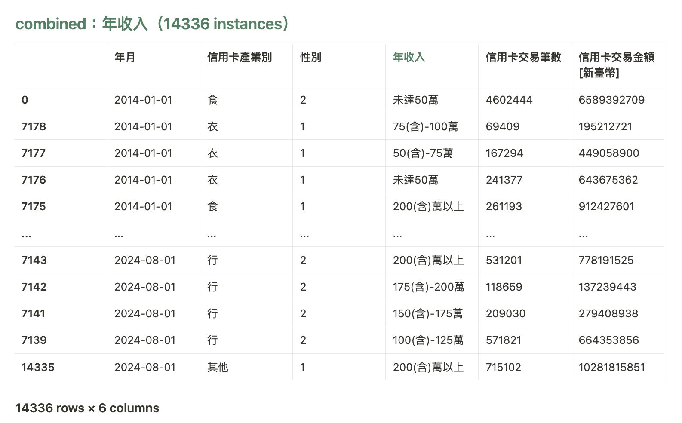
Merge Tables -> One-Hot Encoding -> Data Cleaning -> Exploratory Data Analysis (EDA) -> Data Splitting -> Feature Selection -> Model Training -> Model Evaluation
Merged table：Income Group
IDA Template

Slide 9
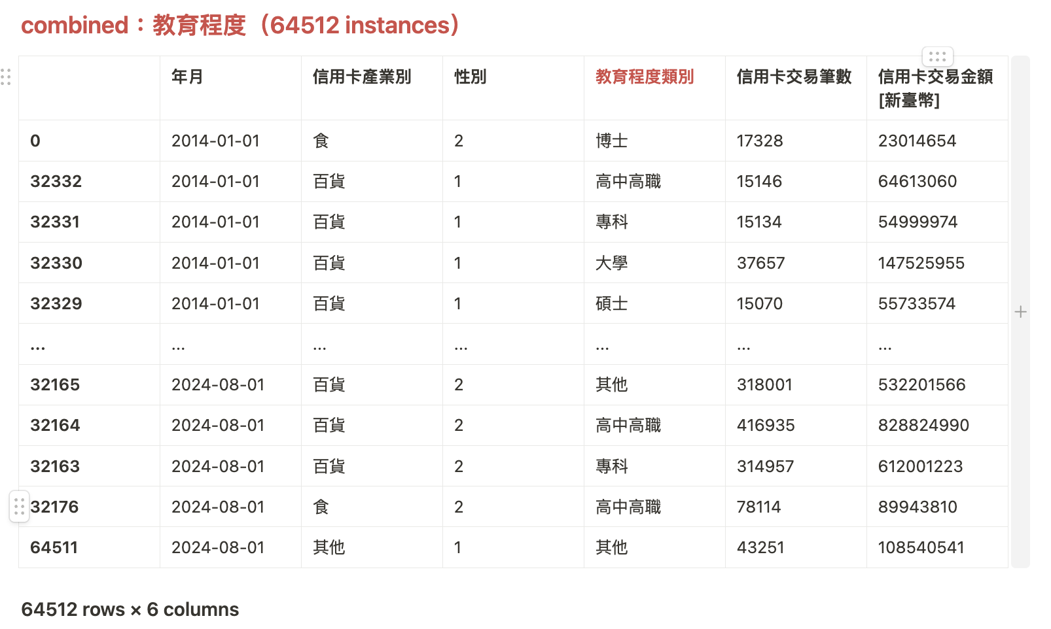
Merge Tables -> One-Hot Encoding -> Data Cleaning -> Exploratory Data Analysis (EDA) -> Data Splitting -> Feature Selection -> Model Training -> Model Evaluation
Merged table：Education Level
IDA Template

Slide 10
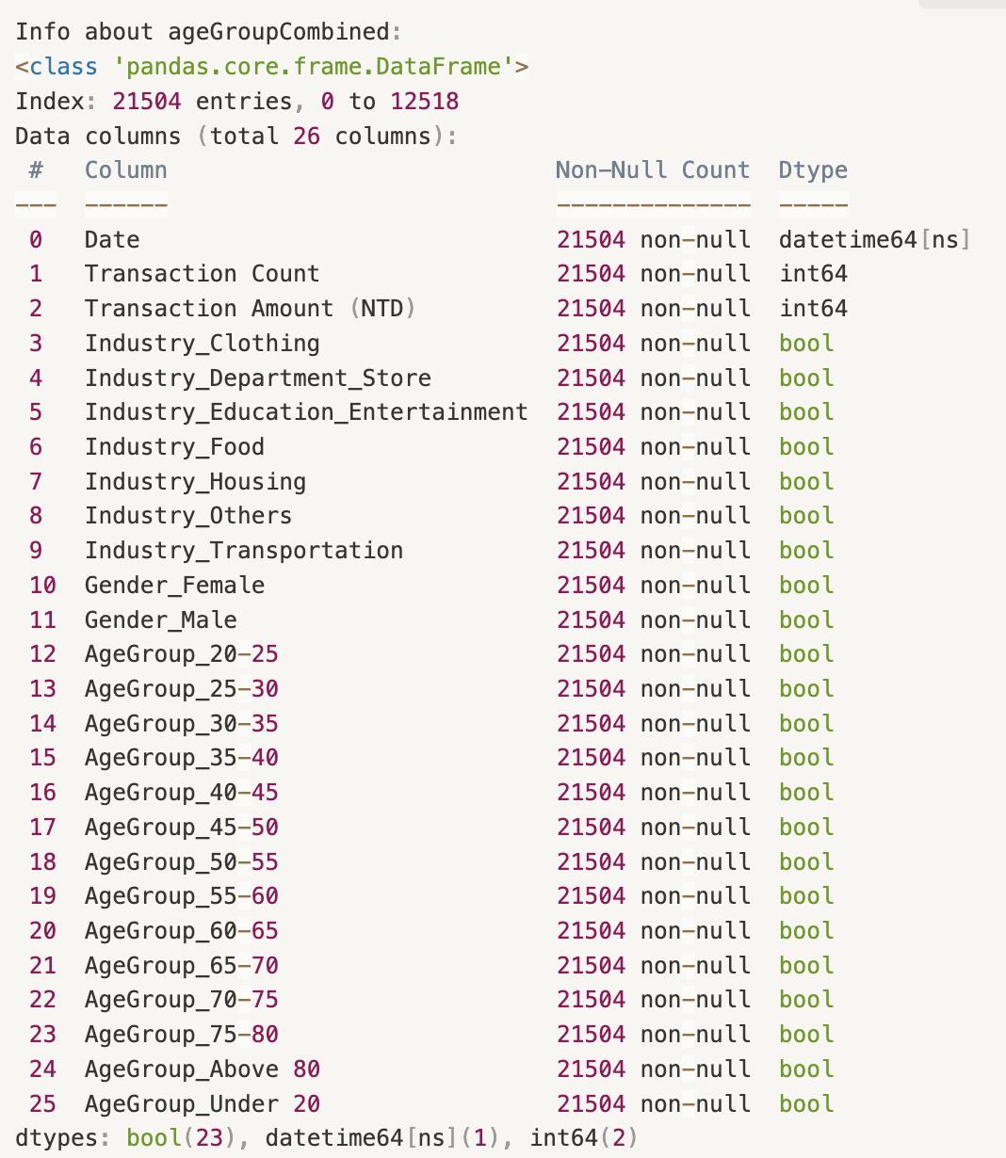
Merge Tables -> One-Hot Encoding -> Data Cleaning -> Exploratory Data Analysis (EDA) -> Data Splitting -> Feature Selection -> Model Training -> Model Evaluation
One-hot encoding：age group
IDA Template

Slide 11
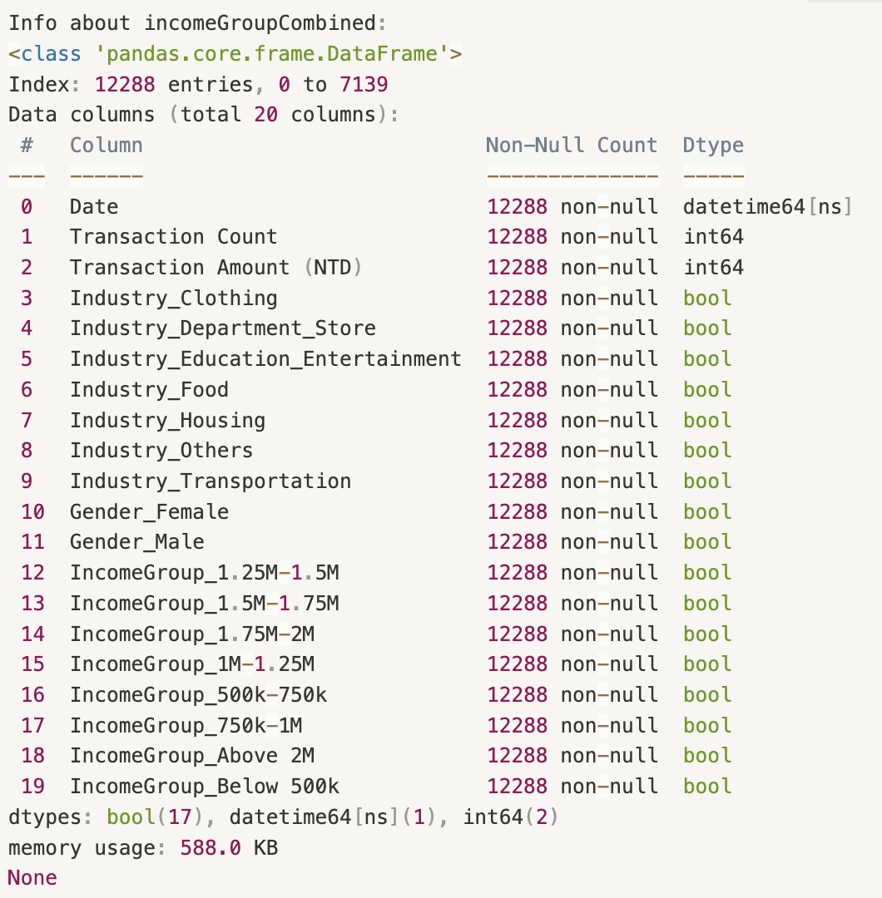
Merge Tables -> One-Hot Encoding -> Data Cleaning -> Exploratory Data Analysis (EDA) -> Data Splitting -> Feature Selection -> Model Training -> Model Evaluation
One-hot encoding：income group
IDA Template

Slide 12
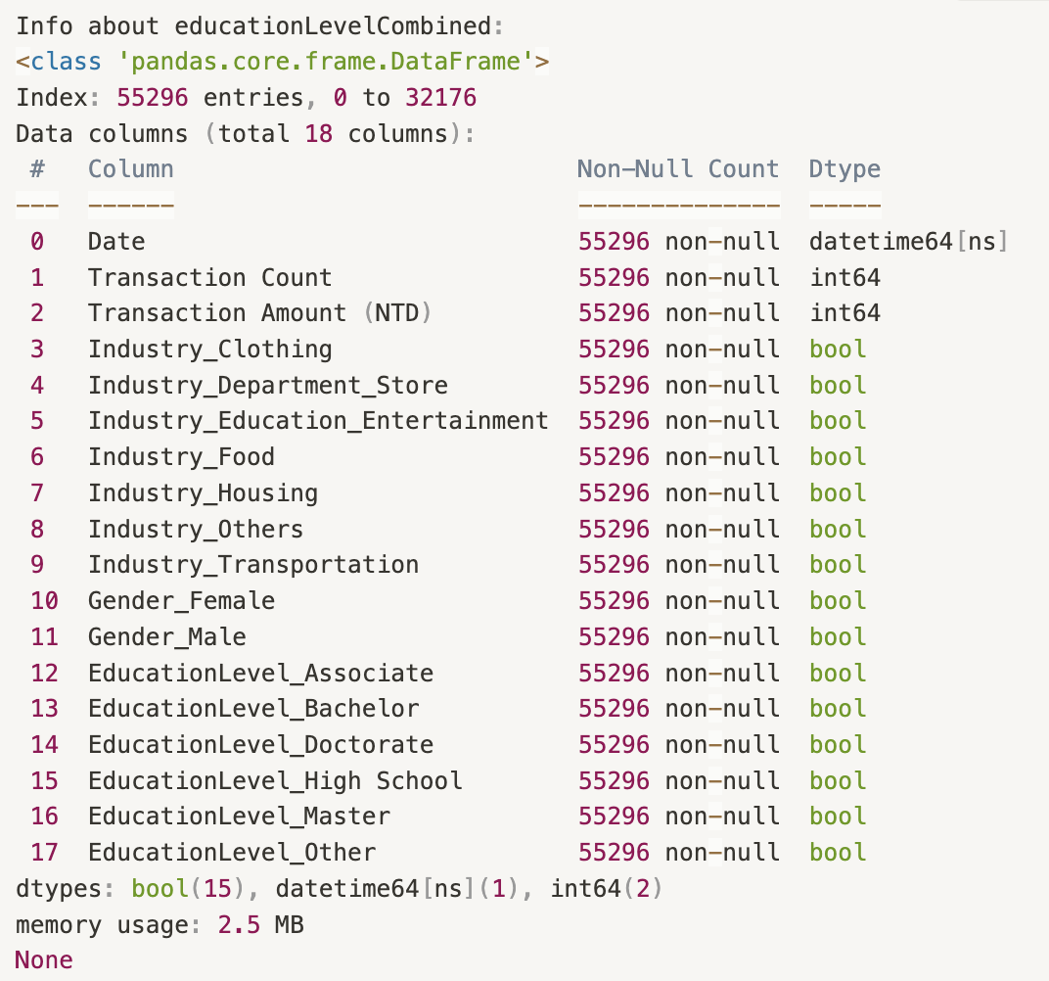
Merge Tables -> One-Hot Encoding -> Data Cleaning -> Exploratory Data Analysis (EDA) -> Data Splitting -> Feature Selection -> Model Training -> Model Evaluation
One-hot encoding：education level
IDA Template

Slide 13
Merge Tables -> One-Hot Encoding -> Data Cleaning -> Exploratory Data Analysis (EDA) -> Data Splitting -> Feature Selection -> Model Training -> Model Evaluation
Data cleaning（’other’ features）
IDA Template

Slide 14
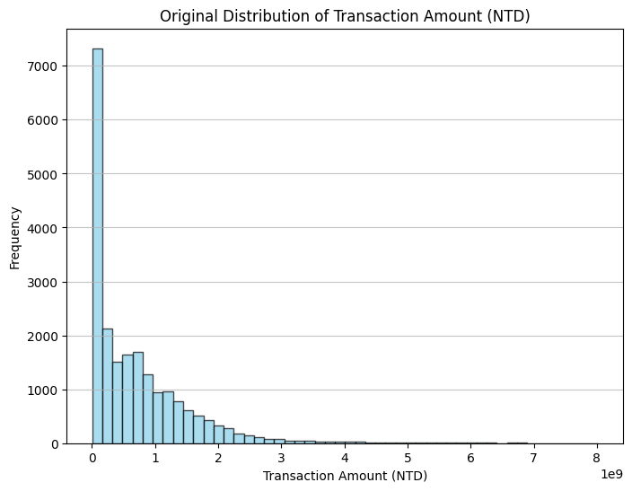
Merge Tables -> One-Hot Encoding -> Data Cleaning -> Exploratory Data Analysis (EDA) -> Data Splitting -> Feature Selection -> Model Training -> Model Evaluation
Data cleaning(outlier)
IDA Template

Slide 15
Merge Tables -> One-Hot Encoding -> Data Cleaning -> Exploratory Data Analysis (EDA) -> Data Splitting -> Feature Selection -> Model Training -> Model Evaluation
Data cleaning(outlier)
IQR (Interquartile Range):
Compute Q1 and Q3 for the transaction amount (Transaction Amount (NTD)) in each industry.
Set the range to [Q1 - 1.5 * IQR, Q3 + 1.5 * IQR].
Additionally, exclude transaction amounts lower than 5,000 NTD.
Reason: To reduce the influence of extreme values on the model and improve model stability and generalization.
IDA Template

Slide 16
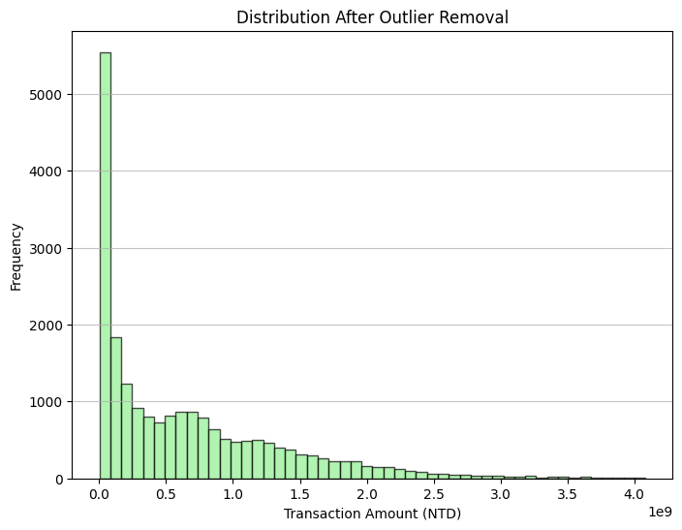
Merge Tables -> One-Hot Encoding -> Data Cleaning -> Exploratory Data Analysis (EDA) -> Data Splitting -> Feature Selection -> Model Training -> Model Evaluation
Data cleaning(outlier)
IDA Template

Slide 17
Merge Tables -> One-Hot Encoding -> Data Cleaning -> Exploratory Data Analysis (EDA) -> Data Splitting -> Feature Selection -> Model Training -> Model Evaluation
Data cleaning(transform)
IDA Template

Slide 18
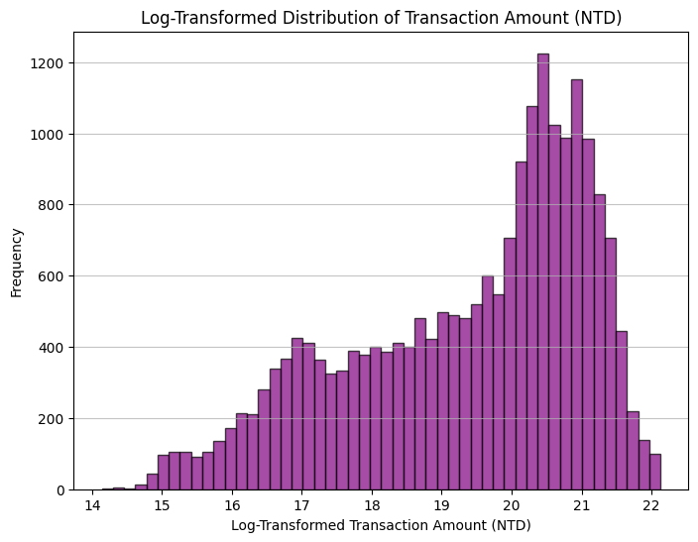
Merge Tables -> One-Hot Encoding -> Data Cleaning -> Exploratory Data Analysis (EDA) -> Data Splitting -> Feature Selection -> Model Training -> Model Evaluation
Data cleaning(transform)
Log Transformation
Target Variable: Transaction Amount (NTD).
Apply a logarithmic transformation (log1p) to handle the skewed distribution of transaction amounts and reduce the impact of high-value transactions.
IDA Template

Slide 19
Merge Tables -> One-Hot Encoding -> Data Cleaning -> Exploratory Data Analysis (EDA) -> Data Splitting -> Feature Selection -> Model Training -> Model Evaluation
EDA
Do key variables (e.g., Age, Income, Education) significantly impact the target variable (transaction amount)?
Do industries influence the relationship between key variables and the target?
Does the distribution of industries across different key variables show consistent patterns in their contribution to transaction amounts?
Does the target variable exhibit any cyclical patterns over time?
IDA Template

Slide 20
Merge Tables -> One-Hot Encoding -> Data Cleaning -> Exploratory Data Analysis (EDA) -> Data Splitting -> Feature Selection -> Model Training -> Model Evaluation
EDA
Correlation Analysis of Key Variables with Transaction Amounts
Correlation Analysis of Industry Categories with Transaction Amounts
Impact of Key Variables (Age, Income, Education) and Industry Categories on Transaction Amounts
Time Series Analysis to Identify Cycles and Evaluate the Importance of Dates for Accurate Data Splitting
IDA Template

Slide 21
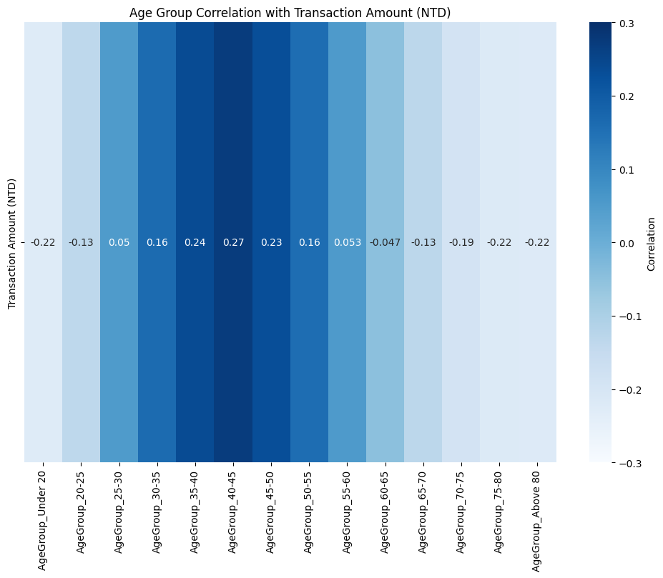
Merge Tables -> One-Hot Encoding -> Data Cleaning -> Exploratory Data Analysis (EDA) -> Data Splitting -> Feature Selection -> Model Training -> Model Evaluation
EDA：age group
Correlation Analysis of
Key Variables with Transaction Amounts
IDA Template
Notes:
The results reveal significant insights into how these variables influence
consumer spending behavior

Slide 22
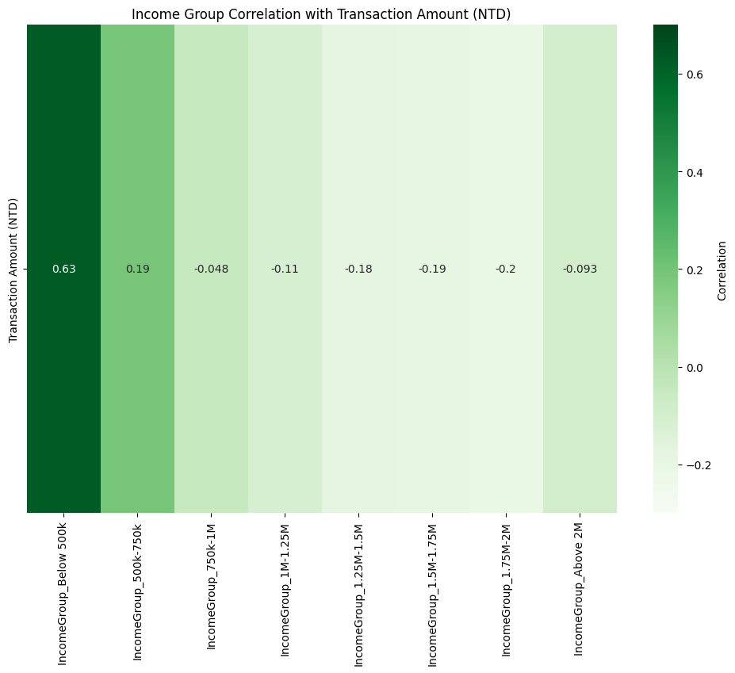
Merge Tables -> One-Hot Encoding -> Data Cleaning -> Exploratory Data Analysis (EDA) -> Data Splitting -> Feature Selection -> Model Training -> Model Evaluation
EDA：income group
Correlation and Distribution Analysis of Individual Variables with Transaction Amounts
IDA Template

Slide 23
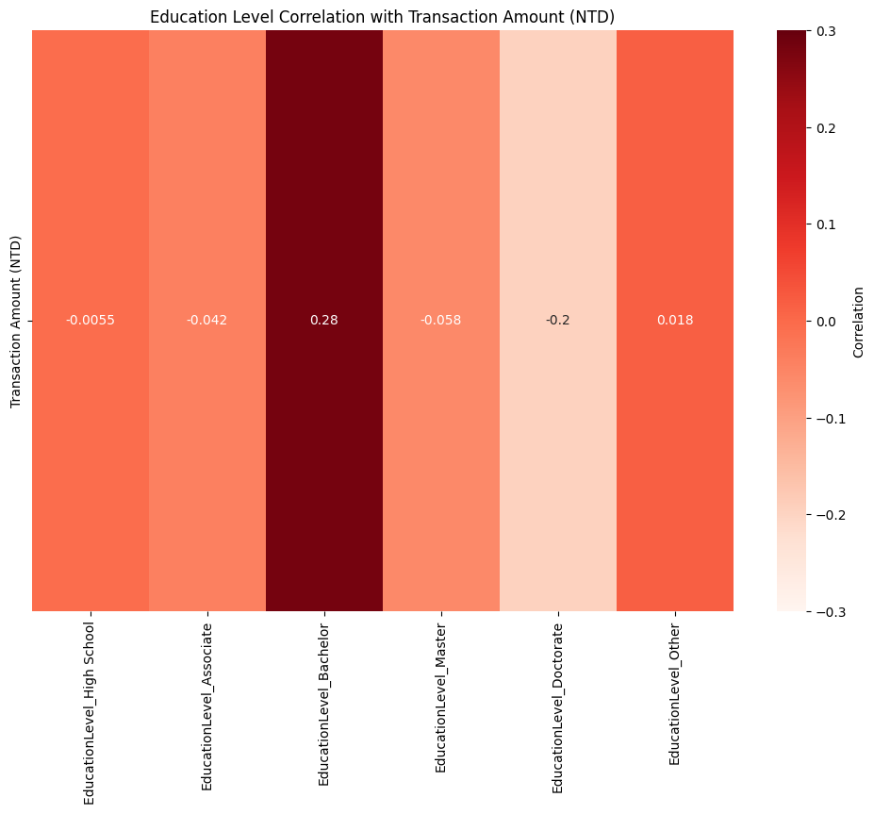
Merge Tables -> One-Hot Encoding -> Data Cleaning -> Exploratory Data Analysis (EDA) -> Data Splitting -> Feature Selection -> Model Training -> Model Evaluation
EDA：education level
Correlation and Distribution Analysis of Individual Variables with Transaction Amounts
IDA Template

Slide 24
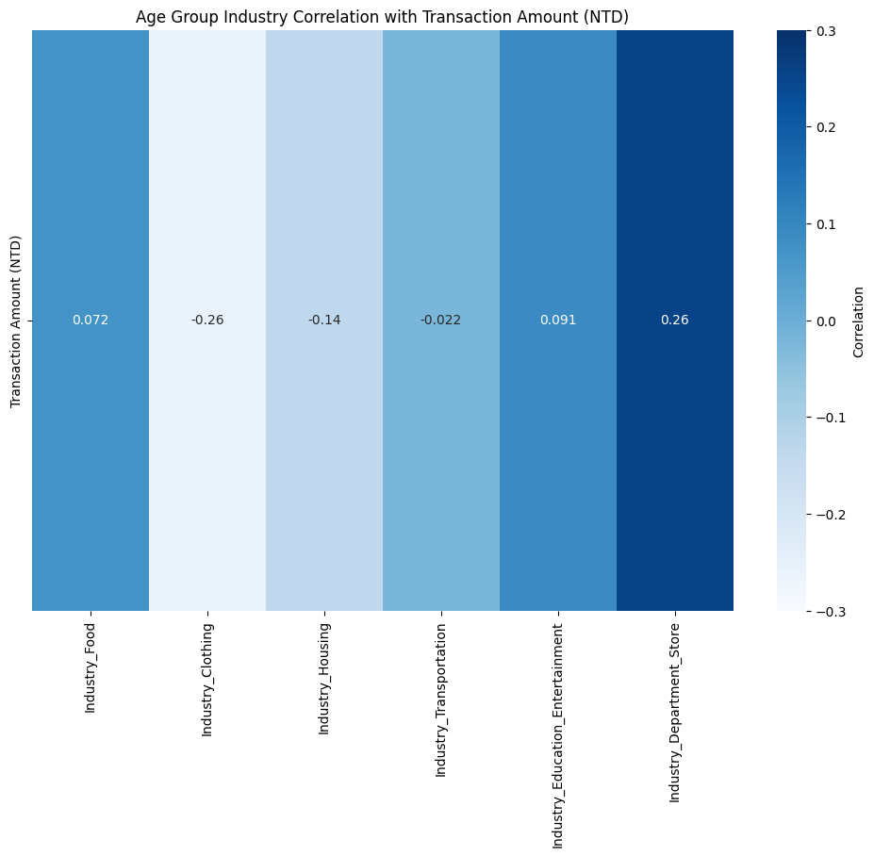
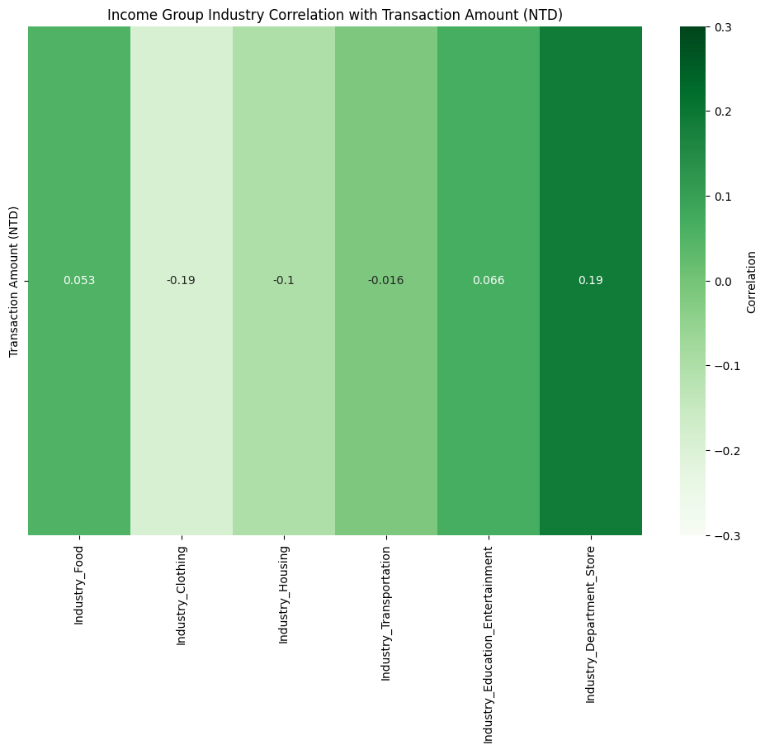
Merge Tables -> One-Hot Encoding -> Data Cleaning -> Exploratory Data Analysis (EDA) -> Data Splitting -> Feature Selection -> Model Training -> Model Evaluation
EDA：
2. Correlation of Industry Categories with Transaction Amounts
IDA Template

Slide 25
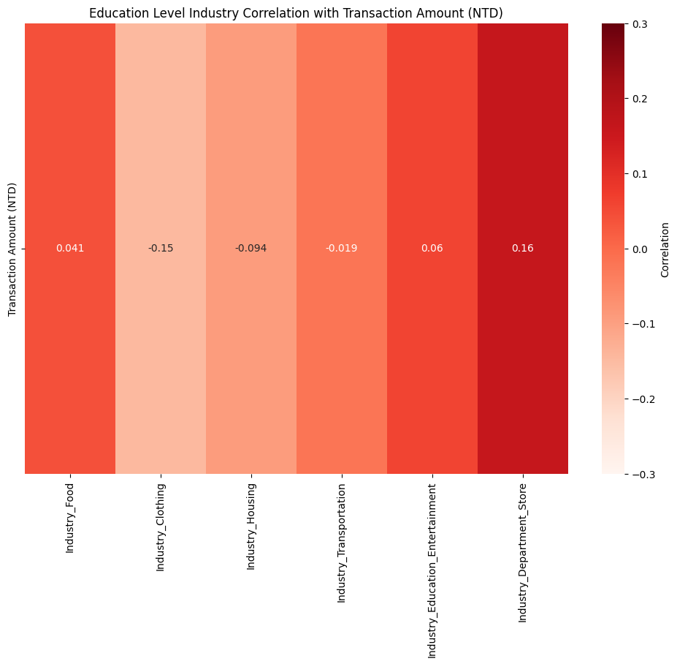
Merge Tables -> One-Hot Encoding -> Data Cleaning -> Exploratory Data Analysis (EDA) -> Data Splitting -> Feature Selection -> Model Training -> Model Evaluation
EDA：
2. Correlation of Industry Categories with Transaction Amounts
IDA Template
Notes:
These findings confirm that industry-specific spending patterns are largely consistent
across age, income, and education groups. Industry 不會隨著key value改變而改變對transaction amount 的影響程度。

Slide 26
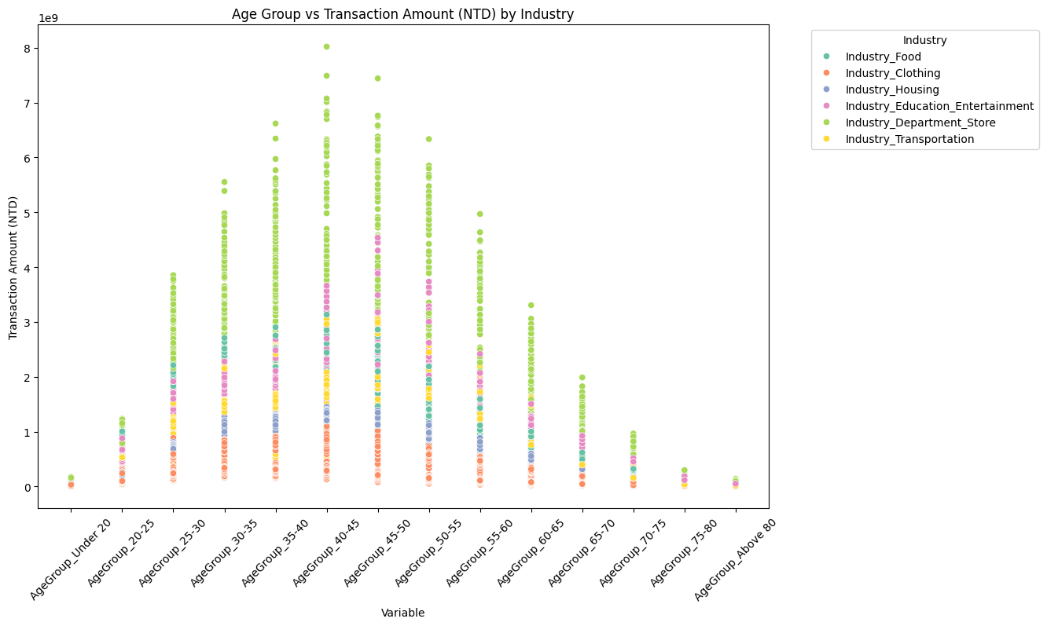
Merge Tables -> One-Hot Encoding -> Data Cleaning -> Exploratory Data Analysis (EDA) -> Data Splitting -> Feature Selection -> Model Training -> Model Evaluation
EDA：age group
3. Impact of Key Variables (Age, Income, Education) and
Industry Categories on Transaction Amounts
IDA Template
Notes:
These findings indicate that industry distributions vary significantly across key variables,
highlighting the need for separate modeling of industries to improve predictive performance.

Slide 27
Merge Tables -> One-Hot Encoding -> Data Cleaning -> Exploratory Data Analysis (EDA) -> Data Splitting -> Feature Selection -> Model Training -> Model Evaluation
EDA：age group
3. Impact of Key Variables (Age, Income, Education) and
Industry Categories on Transaction Amounts
IDA Template

Slide 28
Merge Tables -> One-Hot Encoding -> Data Cleaning -> Exploratory Data Analysis (EDA) -> Data Splitting -> Feature Selection -> Model Training -> Model Evaluation
EDA：age group
3. Impact of Key Variables (Age, Income, Education) and
Industry Categories on Transaction Amounts
IDA Template

Slide 29
Merge Tables -> One-Hot Encoding -> Data Cleaning -> Exploratory Data Analysis (EDA) -> Data Splitting -> Feature Selection -> Model Training -> Model Evaluation
EDA：age group
3. Impact of Key Variables (Age, Income, Education) and
Industry Categories on Transaction Amounts
IDA Template

Slide 30
Merge Tables -> One-Hot Encoding -> Data Cleaning -> Exploratory Data Analysis (EDA) -> Data Splitting -> Feature Selection -> Model Training -> Model Evaluation
EDA：age group
3. Impact of Key Variables (Age, Income, Education) and
Industry Categories on Transaction Amounts
IDA Template

Slide 31
Merge Tables -> One-Hot Encoding -> Data Cleaning -> Exploratory Data Analysis (EDA) -> Data Splitting -> Feature Selection -> Model Training -> Model Evaluation
EDA：age group
3. Impact of Key Variables (Age, Income, Education) and
Industry Categories on Transaction Amounts
IDA Template

Slide 32
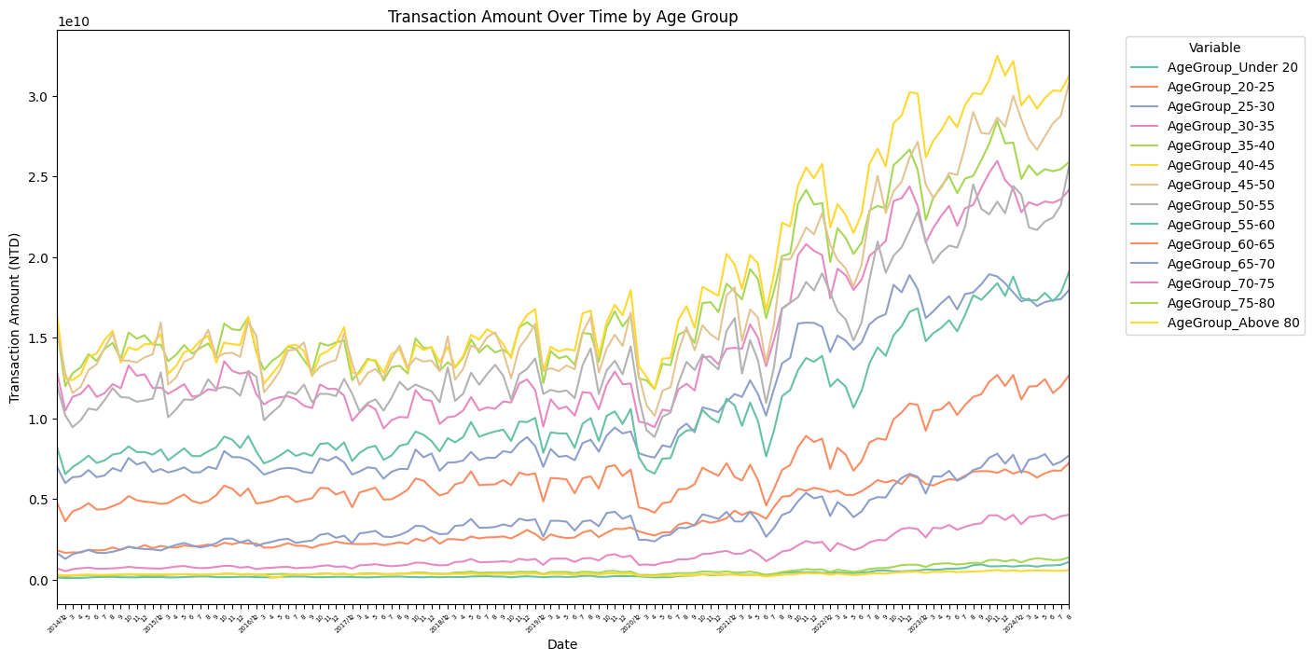
Merge Tables -> One-Hot Encoding -> Data Cleaning -> Exploratory Data Analysis (EDA) -> Data Splitting -> Feature Selection -> Model Training -> Model Evaluation
EDA：age group
4. Time Series Analysis to Identify Cycles and Evaluate the Importance of Dates for Accurate Data Splitting
IDA Template
Notes:
The time series analysis reveals that each key variable demonstrates unique trends while collectively exhibiting periodicity.

Slide 33
Merge Tables -> One-Hot Encoding -> Data Cleaning -> Exploratory Data Analysis (EDA) -> Data Splitting -> Feature Selection -> Model Training -> Model Evaluation
Data Splitting（industries）
 | date | f2 | f3 | … | fn | target
x1
x2
…
x30
clothing、department store、education、food
、housing、transportation
industry
 | date | f2 | f3 | … | fn-5 | target
x1
x2
…
x30
*6 data sets
IDA Template

Slide 34
Merge Tables -> One-Hot Encoding -> Data Cleaning -> Exploratory Data Analysis (EDA) -> Data Splitting -> Feature Selection -> Model Training -> Model Evaluation
Data Splitting（rolling windows）
Utilize 80% of the data for training and 20% for testing.
Set a window size of 30 days for feature framing.
 | date | f2 | f3 | … | fn-5 | target
x1
x2
…
x30
x31 |  |  |  |  |  | target
IDA Template

Slide 35
Merge Tables -> One-Hot Encoding -> Data Cleaning -> Exploratory Data Analysis (EDA) -> Data Splitting -> Feature Selection -> Model Training -> Model Evaluation
Data selection
Top feature names: [
'Transaction Count_t-29’,
'Transaction Count_t-28’,
'AgeGroup_45-50_t-29’,
'AgeGroup_40-45_t-29’,
'AgeGroup_35-40_t-29’,
'AgeGroup_30-35_t-29’,
'AgeGroup_50-55_t-29’... ]
Correlation values: [0.21883816467937536, 0.12935893926542502, 0.09250959148474633, 0.09097169679091024, 0.08300890956894194, 0.07668582728125771, 0.07527391774477073, 0.0733772624264886, 0.07300706512182722, 0.07223371419053244]
IDA Template

Slide 36
Merge Tables -> One-Hot Encoding -> Data Cleaning -> Exploratory Data Analysis (EDA) -> Data Splitting -> Feature Selection -> Model Training -> Model Evaluation
Model training
Model Training
regression
KNN
LSTM
Model Evaluation: Evaluate the trained models by calculating the
MAE on predicted transaction amounts to assess performance.
https://colab.research.google.com/drive/1qisyzdtg_6noBucy7kgTU5wvBv9KcMgp?usp=sharing

Slide 37
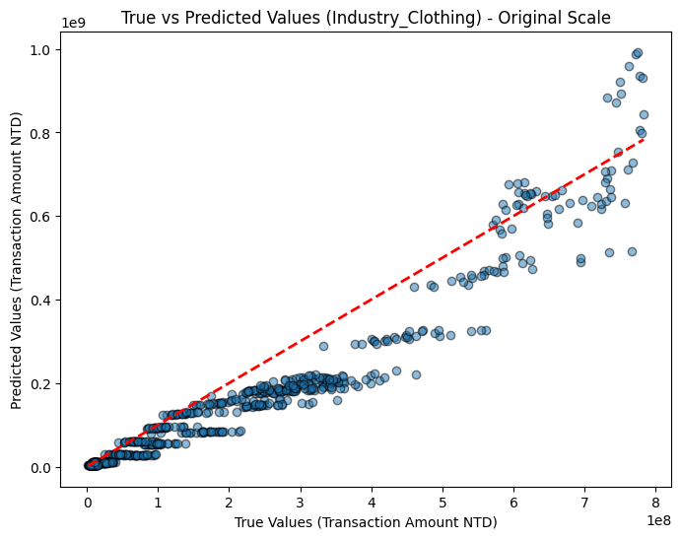
Merge Tables -> One-Hot Encoding -> Data Cleaning -> Exploratory Data Analysis (EDA) -> Data Splitting -> Feature Selection -> Model Training -> Model Evaluation
Model Evaluation (linear regression)
Regression
MAE Linear regression: 0.727
https://colab.research.google.com/drive/1qisyzdtg_6noBucy7kgTU5wvBv9KcMgp?usp=sharing

Slide 38
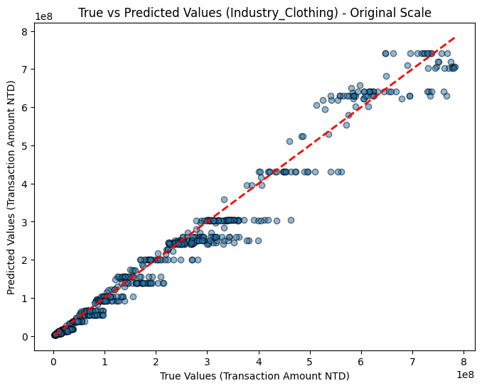
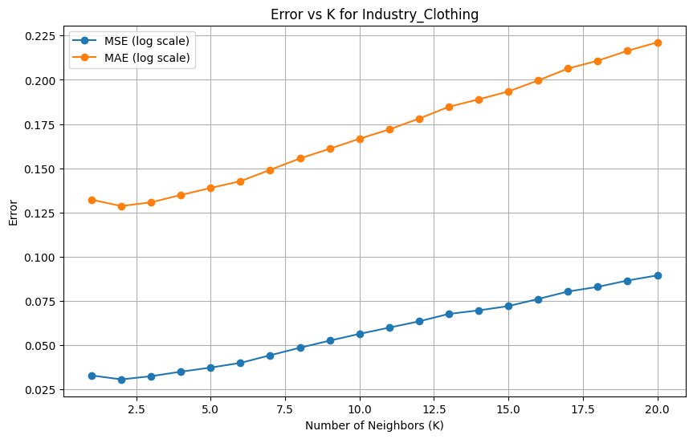
Merge Tables -> One-Hot Encoding -> Data Cleaning -> Exploratory Data Analysis (EDA) -> Data Splitting -> Feature Selection -> Model Training -> Model Evaluation
Model Evaluation (KNN)
KNN
Regression
MAE KNN: 0.167
https://colab.research.google.com/drive/1qisyzdtg_6noBucy7kgTU5wvBv9KcMgp?usp=sharing

Slide 39
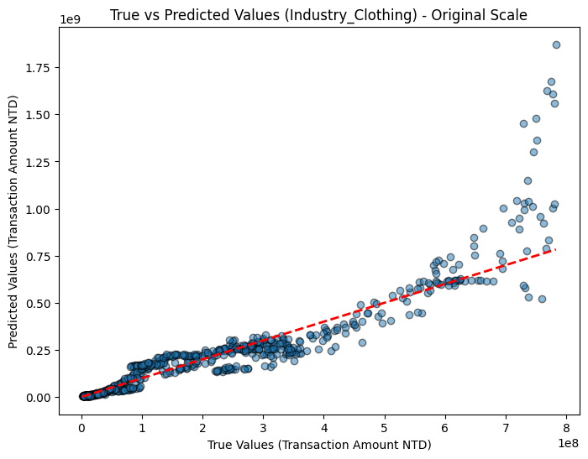
Merge Tables -> One-Hot Encoding -> Data Cleaning -> Exploratory Data Analysis (EDA) -> Data Splitting -> Feature Selection -> Model Training -> Model Evaluation
Model Evaluation (LSTM)
KNN
Regression
LSTM
MAE LSTM:0.301
https://colab.research.google.com/drive/1qisyzdtg_6noBucy7kgTU5wvBv9KcMgp?usp=sharing

Slide 40
Merge Tables -> One-Hot Encoding -> Data Cleaning -> Exploratory Data Analysis (EDA) -> Data Splitting -> Feature Selection -> Model Training -> Model Evaluation
Model Evaluation (LSTM)
KNN
Regression
LSTM
MAE LSTM:0.301
https://colab.research.google.com/drive/1qisyzdtg_6noBucy7kgTU5wvBv9KcMgp?usp=sharing

Slide 41
Merge Tables -> One-Hot Encoding -> Data Cleaning -> Exploratory Data Analysis (EDA) -> Data Splitting -> Feature Selection -> Model Training -> Model Evaluation
Model Evaluation (linear regression, KNN, LSTM)
Regression
KNN
LSTM
MAE:
Linear regression: 0.727
KNN: 0.167
LSTM: 0.301
https://colab.research.google.com/drive/1qisyzdtg_6noBucy7kgTU5wvBv9KcMgp?usp=sharing

Slide 42
Merge Tables -> One-Hot Encoding -> Data Cleaning -> Exploratory Data Analysis (EDA) -> Data Splitting -> Feature Selection -> Model Training -> Model Evaluation
Model Evaluation (linear regression, KNN, LSTM)
Regression
KNN
LSTM
MAE:
Linear regression: 0.727
KNN: 0.167
LSTM: 0.301
https://colab.research.google.com/drive/1qisyzdtg_6noBucy7kgTU5wvBv9KcMgp?usp=sharing

Slide 43
Merge Tables -> One-Hot Encoding -> Data Cleaning -> Exploratory Data Analysis (EDA) -> Data Splitting -> Feature Selection -> Model Training -> Model Evaluation
Model Evaluation (KNN, LSTM)
LSTM
KNN
https://colab.research.google.com/drive/1qisyzdtg_6noBucy7kgTU5wvBv9KcMgp?usp=sharing

Slide 44
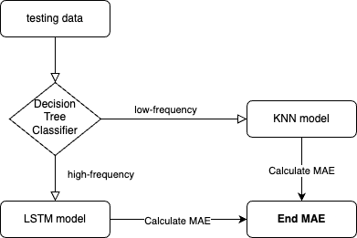
Merge Tables -> One-Hot Encoding -> Data Cleaning -> Exploratory Data Analysis (EDA) -> Data Splitting -> Feature Selection -> Model Training -> Model Evaluation
Model Evaluation (KNN, LSTM)
LSTM
KNN
https://colab.research.google.com/drive/1qisyzdtg_6noBucy7kgTU5wvBv9KcMgp?usp=sharing

Slide 45
Merge Tables -> One-Hot Encoding -> Data Cleaning -> Exploratory Data Analysis (EDA) -> Data Splitting -> Feature Selection -> Model Training -> Model Evaluation
Model Evaluation (KNN, LSTM)
LSTM
KNN
https://colab.research.google.com/drive/1qisyzdtg_6noBucy7kgTU5wvBv9KcMgp?usp=sharing

Slide 46
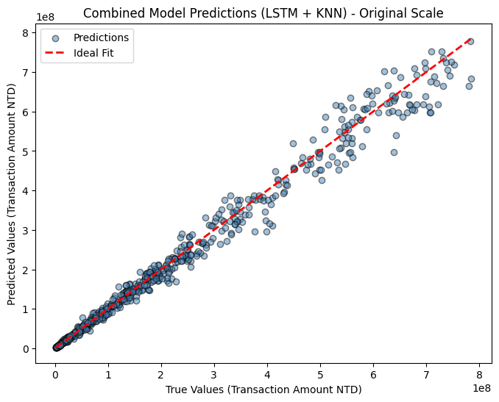
Merge Tables -> One-Hot Encoding -> Data Cleaning -> Exploratory Data Analysis (EDA) -> Data Splitting -> Feature Selection -> Model Training -> Model Evaluation
Model Evaluation (KNN+LSTM)
KNN
Regression
LSTM
MAE LSTM: 0.086
https://colab.research.google.com/drive/1qisyzdtg_6noBucy7kgTU5wvBv9KcMgp?usp=sharing

Slide 47
Merge Tables -> One-Hot Encoding -> Data Cleaning -> Exploratory Data Analysis (EDA) -> Data Splitting -> Feature Selection -> Model Training -> Model Evaluation
Model Evaluation (ALL)
Model | MAE
Linear regression | 0.727
KNN | 0.167
LSTM | 0.301
KNN and LSTM | 0.086
https://colab.research.google.com/drive/1qisyzdtg_6noBucy7kgTU5wvBv9KcMgp?usp=sharing

Slide 48
Merge Tables -> One-Hot Encoding -> Data Cleaning -> Exploratory Data Analysis (EDA) -> Data Splitting -> Feature Selection -> Model Training -> Model Evaluation
Model training (KNN + LSTM)
https://colab.research.google.com/drive/1qisyzdtg_6noBucy7kgTU5wvBv9KcMgp?usp=sharing

